Slide 1
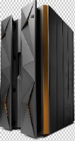
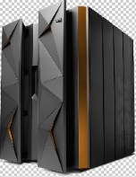
ZD&T Solution
Master system Image
MS – Test LPAs (multiplex)
MS – Test LPAs (multiplex
MS – Test LPA (monoplex)
RES
SYS
USS
DB2/CICS/IMS
RES
SYS
Generic setup & data
USS
DB2/CICS/IMS
App1
App2
App3
App4
generic setup & data
zD&T Provisioning ools build system volumes
Infosys Application Build tools/ accelerators to build application
System Image
System Image
System Image
System Image
System volumes
App1
System volumes
App2
System volumes
App3
System volumes
App4
ZD&T Image1
ZD&T Image2
ZD&T Image3
ZD&T Image4

Slide 2
Backup & Clone
MS – Test LPAs (multiplex
ZD&T Image1
MS – Test LPA (monoplex)
App1
RES
SYS
System Image
System volumes
USS
DB2/CICS/IMS
generic setup & data
zD&T provisioning Tools build system volumes
Application backup image.
System Image
System volumes
App1
ZD&T Clone of App1

